Slide 1

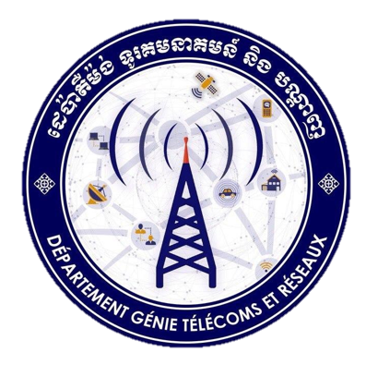
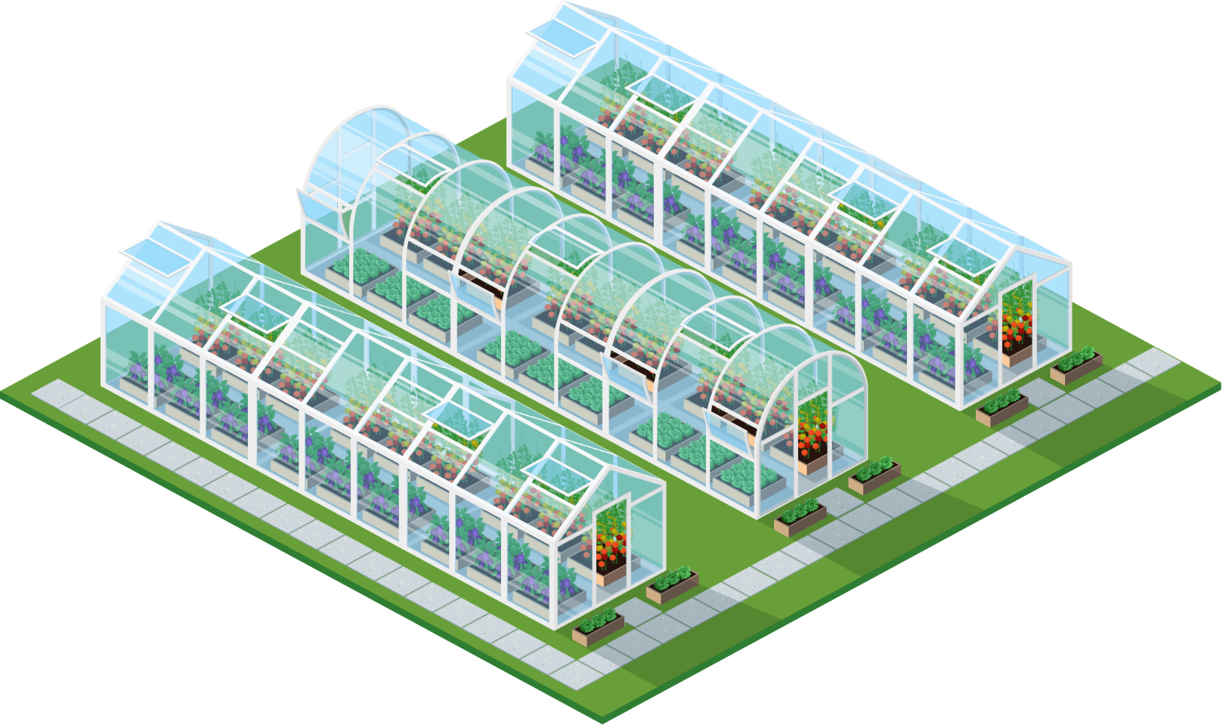
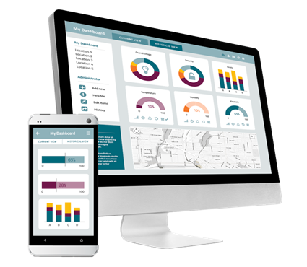
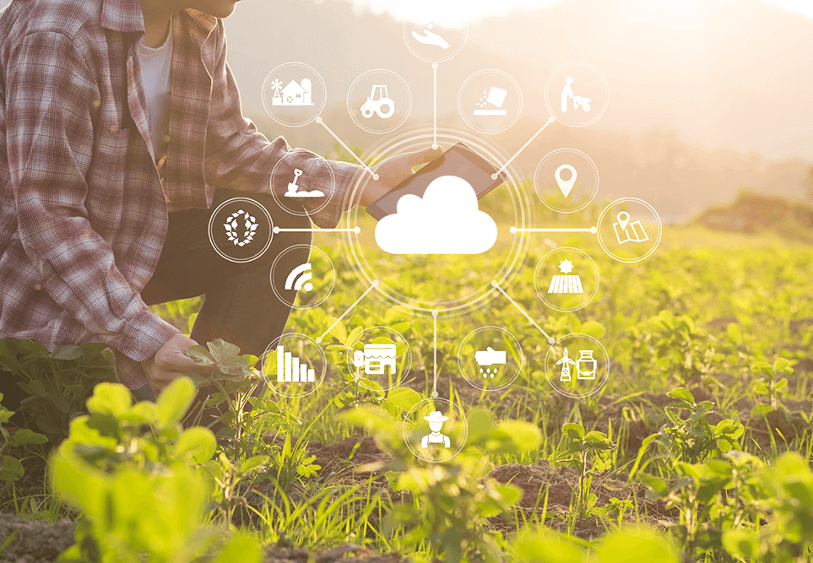
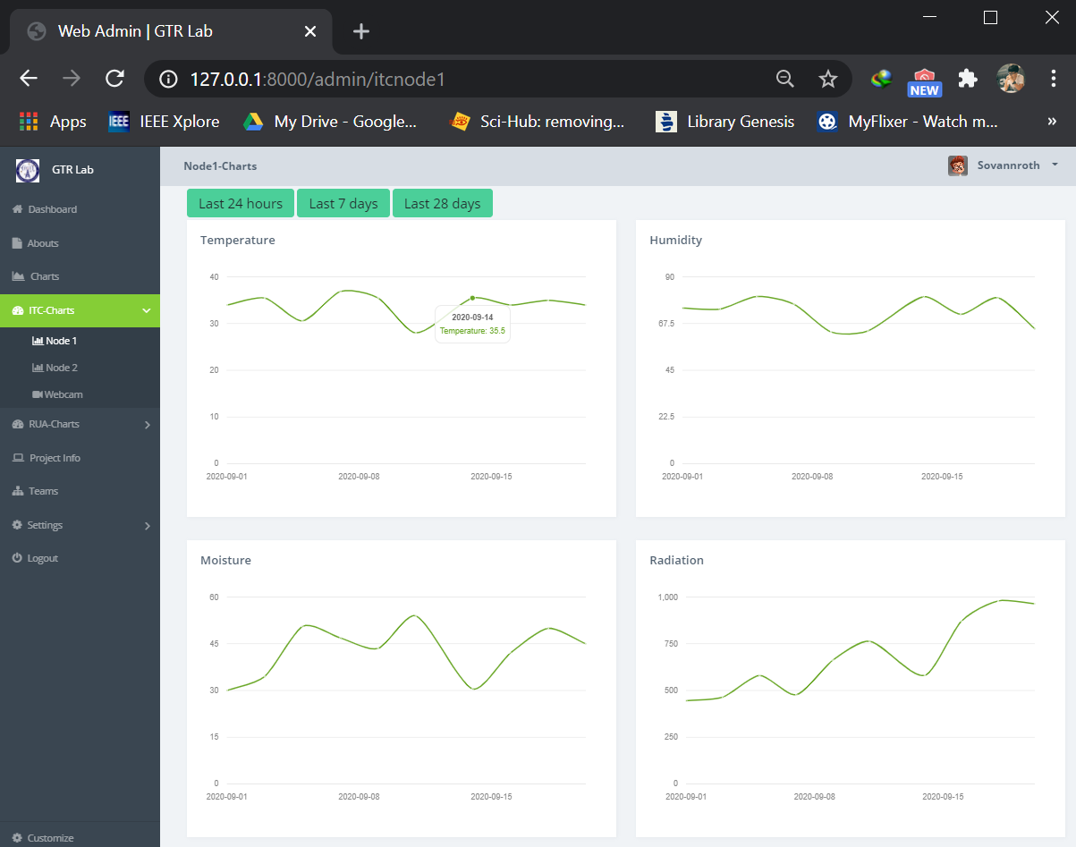

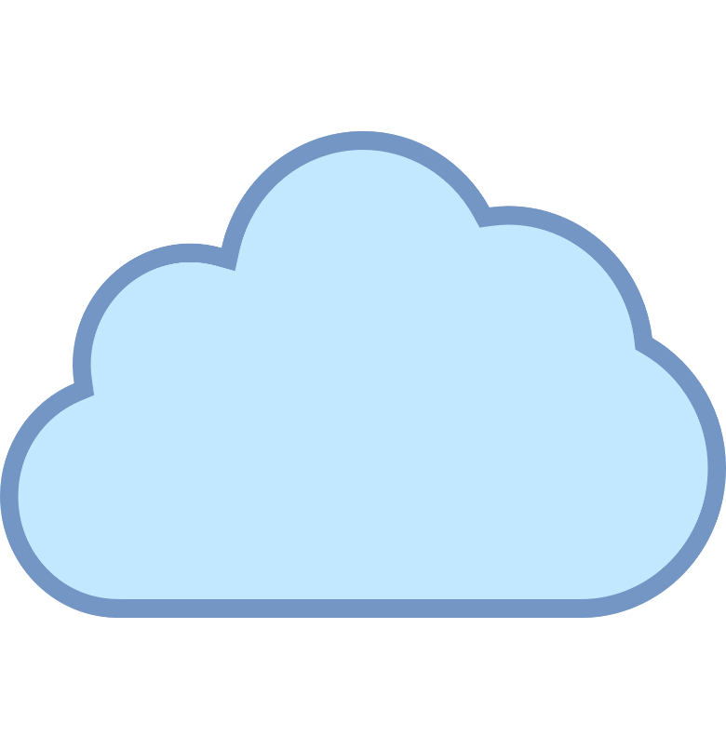

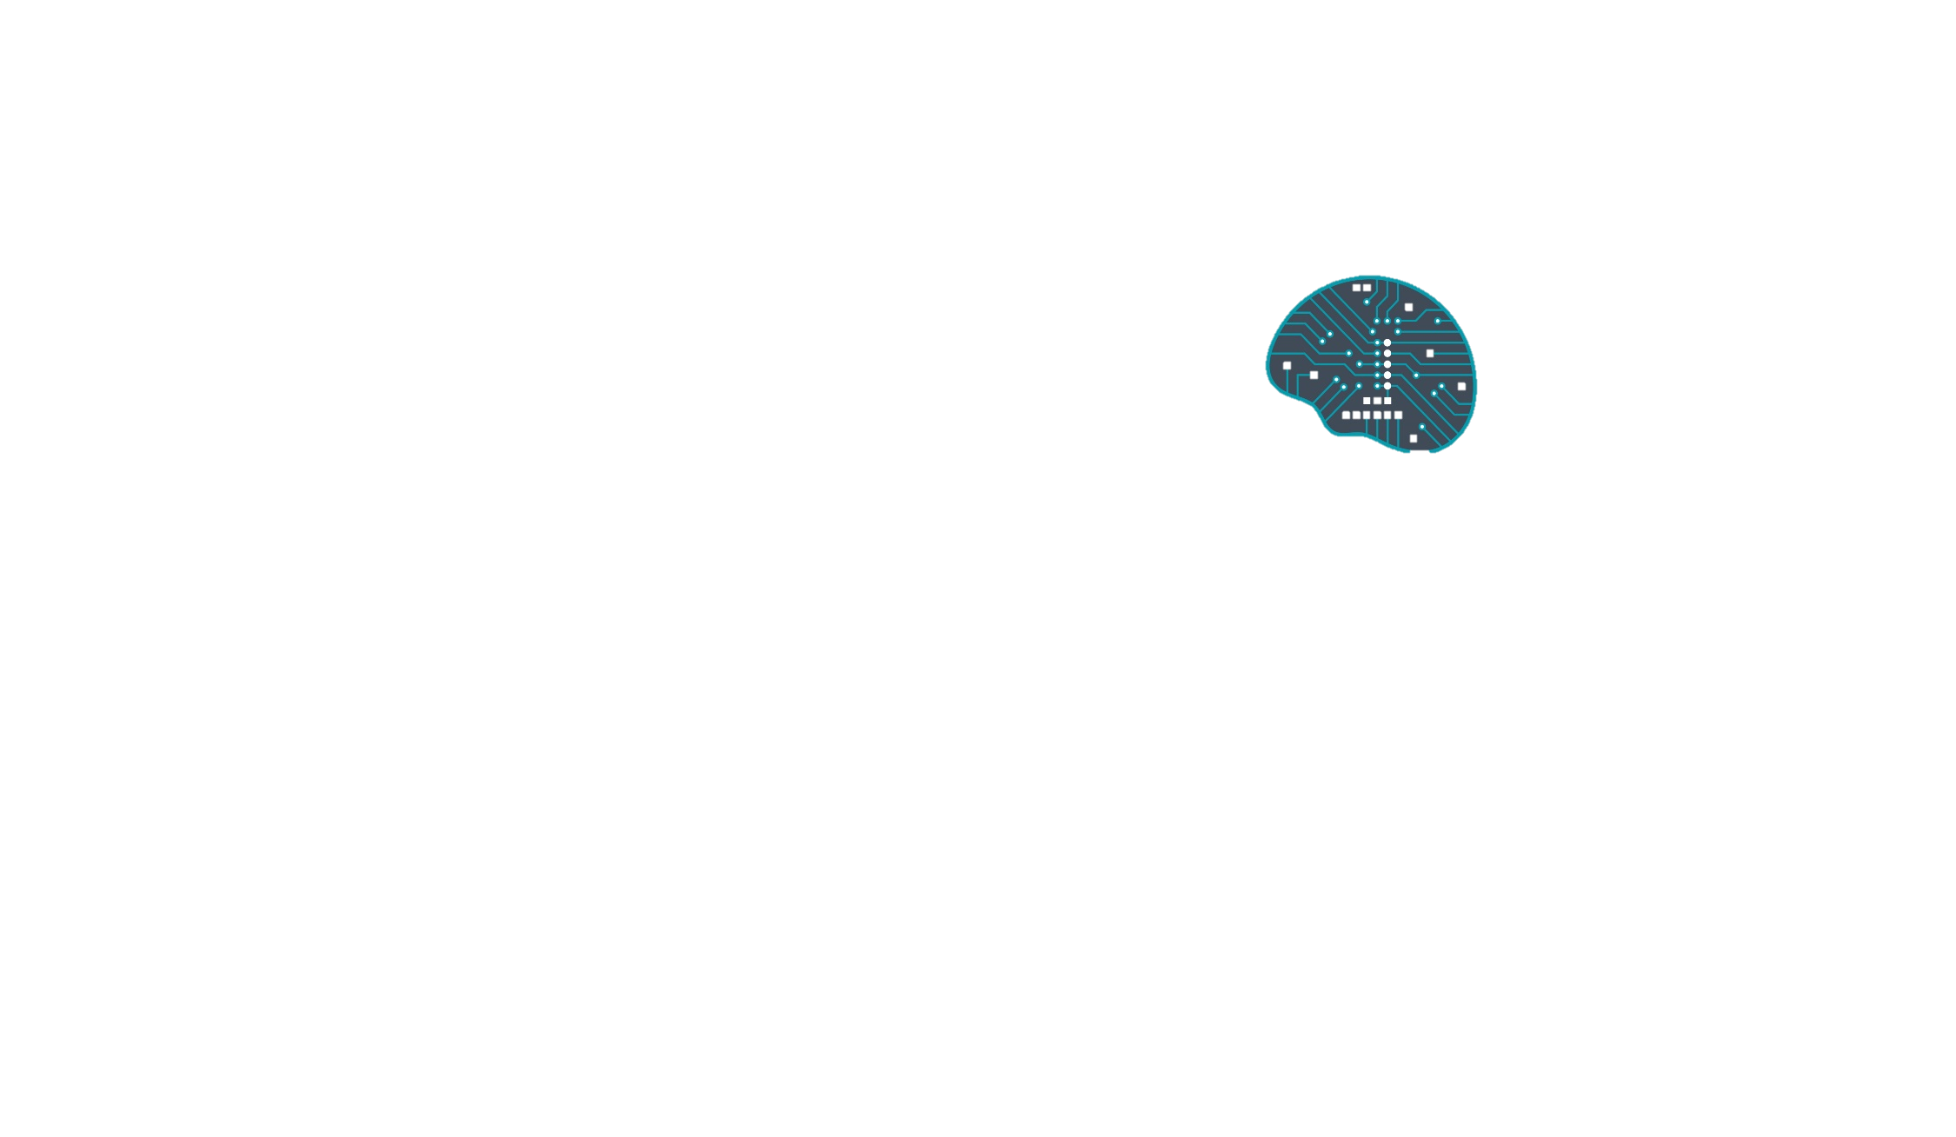
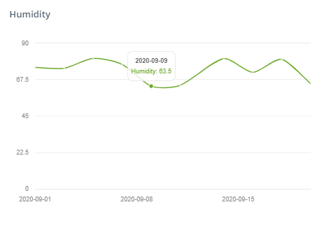
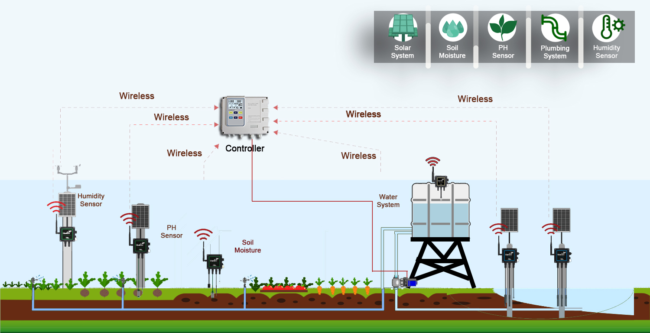

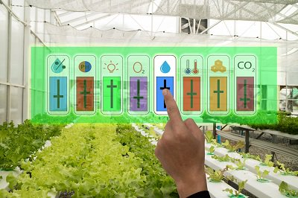
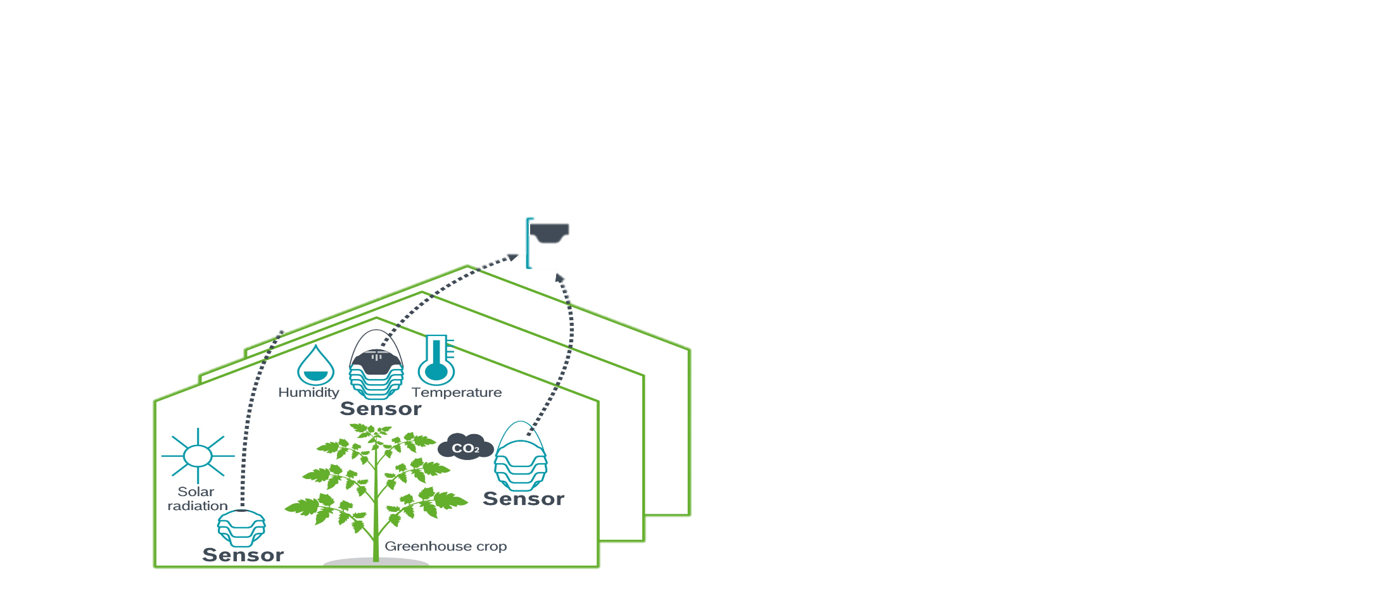
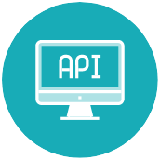
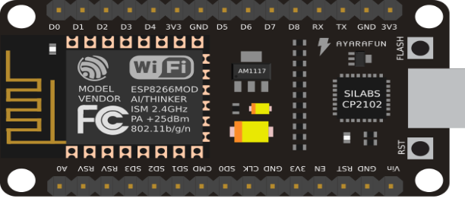
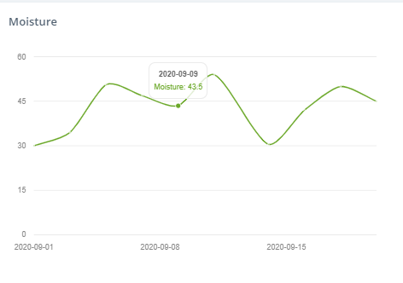
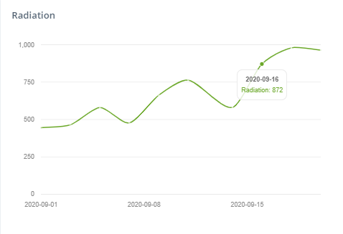
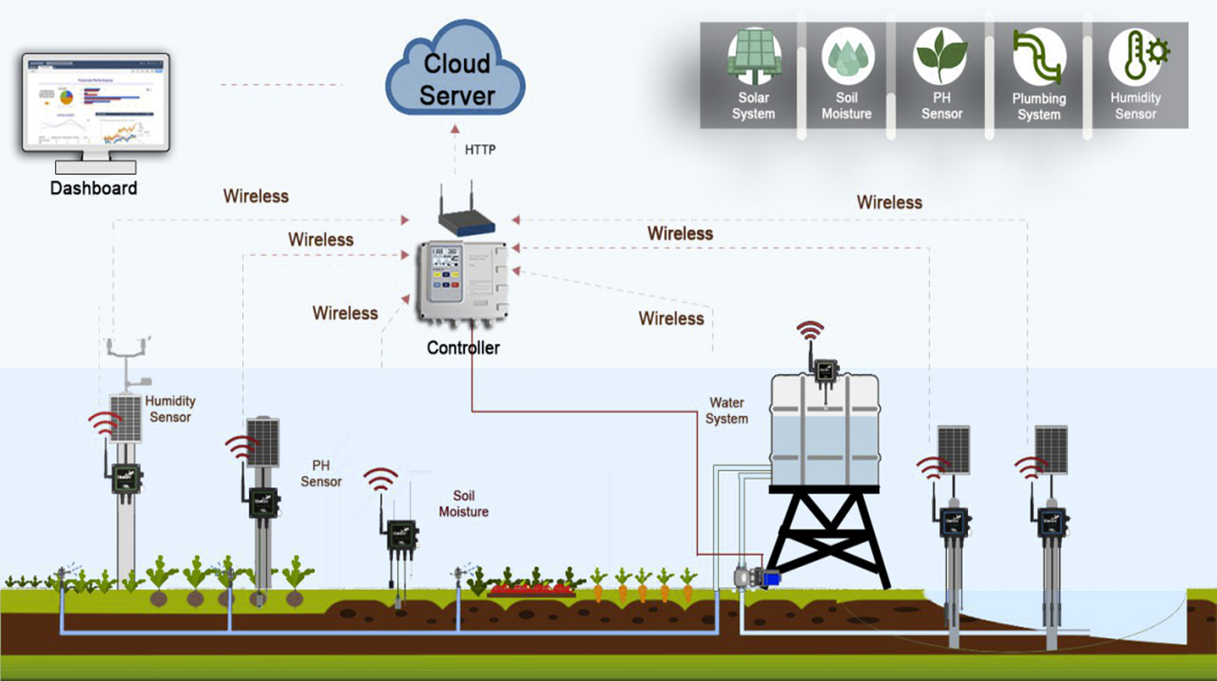
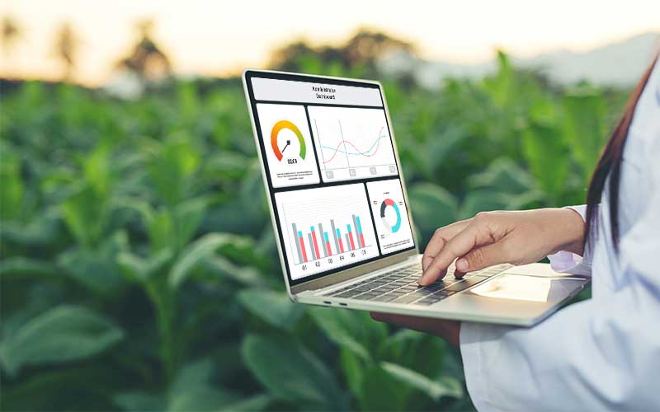
IoT Platform Cloud Storage for Agricultural Application
Advisor : Mr. HEL Chanthan
Researcher: Mr. VANNAK Sovannroth
INDRODUCTION
SYSTEM ARCHITECTURE
PROCESSING
This project focuses on IoT platform cloud storage for agricultural application, I will develop web/mobile application that it is a IoT analytics platform service that allows us to aggregate, visualize and analyze live data streams in the cloud, it provides instant visualizations of data posted by devices. It will view data value of temperature, soil moisture, humidity, PH, and solar radiation on dashboard as line charts and it will view videos record of plant growth from webcam in greenhouse on frontend and backend (web/mobile application). AI is included in this project by combining IoT platform with machine learning, it is data analytics for intelligent agriculture that analyzes farm data and monitoring on IoT platform.
In this project, the plants were grown are growing inside a greenhouse that able to monitor and control the environment factors at any time, from anywhere, through the Internet.
The Arduino Uno, Raspberry Pi and NodeMCU/ESP8266 are used as the main processor to control and capture environmental factors such as: temperature, humidity, soil moisture, solar radiation, PH value, and webcam, then send those significant parameters to store in the could service, over the Internet.
Fig. 3. Greenhouse
The IoT devices are used to measure temperature, humidity, soil moisture, webcam, and water PH values in the greenhouse. The captured those environmental factors are able to display on mobile/web application through some an internet cloud service.
Fig. 7. IoT Platform
Farmers
Web/Mobile Application
Cloud
Database
AI
Fig. 4. Smart Phone IoT device
Farmers are able to maintain, monitor, and control the real-time environment of the smart farm by using mobile/web application, remotely or can be locally either, to ensure an environment conducive to the growth of plants.
Webcam
Green House
ESP8266
API
Fig. 1. The Proposed Smart Farm
Fig. 5. Remote Control Sensors
OBJECTIVES
The farmers will able to access that real-time environment information, monitor and analyze plant growth via web/mobile application. Based on statically information displayed, farmers can manually or automatically control the watering pump,
Fig. 8. Data views on dashboard
CONCLUSIONS
and/or airflow fan to create suitable environment for growing the plants in the greenhouse. The real-time environmental parameters are able to display, and also able to control environment of the farm off-line or on-line.
This project is developing a smart irrigation for smart farm by deploying IoT technology. It based on monitoring systems are in great demand and gives a precise extraction and analysis of data. Using this system a farmer can share/access the innovative techniques used by him/other farmers to improve the yield, can get the details about irrigation based on moisture control and temperature, crop maintaining information, pesticide details for his farm. Through this framework a farmer can get latest updates via smart-phone/web application.
Fig. 2. Farmer views data on dashboard
Fig. 6. System Architecture of Smart Irrigation

